Slide 1


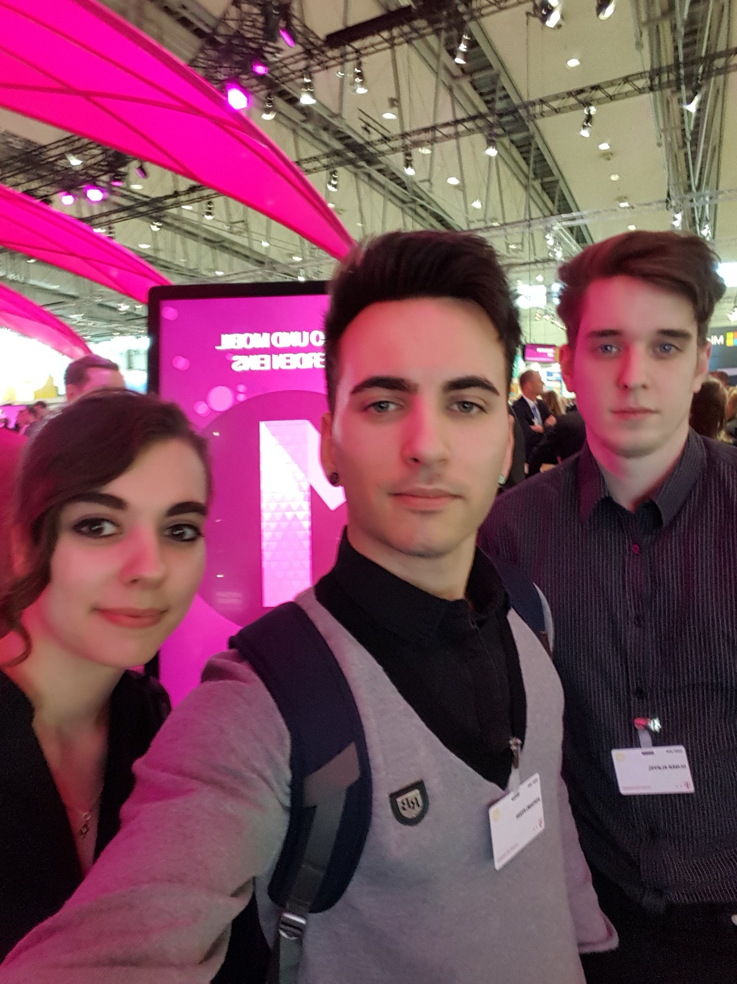
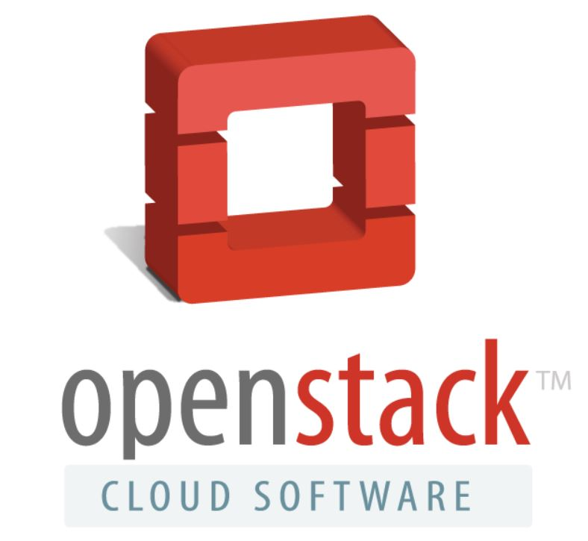
„Cloud Kindergarten“
Apprentices starting with

Slide 2


Agenda
1. | Introduction
1.1 | Who Are We?
1.2 | Our Workflow
2. | TelekomCLOUD + OpenStack
2.1 | Refcard Overview
2.2 | Our Deployment
3. | OpenStack In Practice
3.1 | CI / CD in Git
3.2 | Video „Creating a tenant with OpenStack“
4. | Q & A

Slide 3
1. Introduction

Slide 4
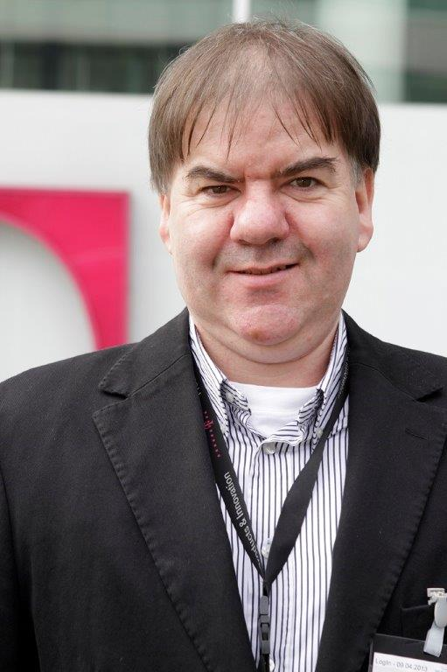
1.1 Who are we? – Mentor
Person
Name : Frank Kloeker
Education
27 years of experience in Operations
Today
Applicationmanagement for Cloud hosting platform
From : Berlin
personal point of contact for Apprentices
Company : Deutsche Telekom AG
Business Unit : Business Applications & Cloud Services
10 years Examiner on Chamber of Commerce and Industry
1. Introduction
2. TelekomCLOUD + OpenStack
3. OpenStack In Practice
4. Q & A

Slide 5
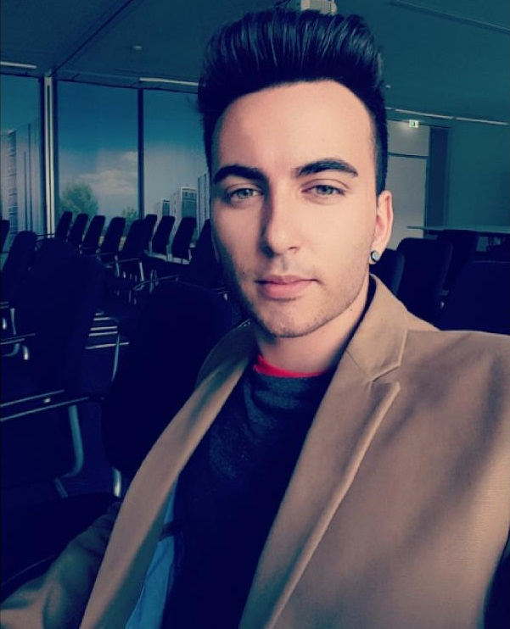
1.1 Who Are We ? – Apprentice
Person
Education
Today
Name : Adriano Perri
Age : 23
From : Berlin
Abitur
studied 2 semester geoecology
Apprenticeship until 2018
Vocation : management assistant in IT systems
Company : Deutsche Telekom AG
Business Unit : Business Applications & Cloud Services
1. Introduction
2. TelekomCLOUD + OpenStack
3. OpenStack In Practice
4. Q & A

Slide 6
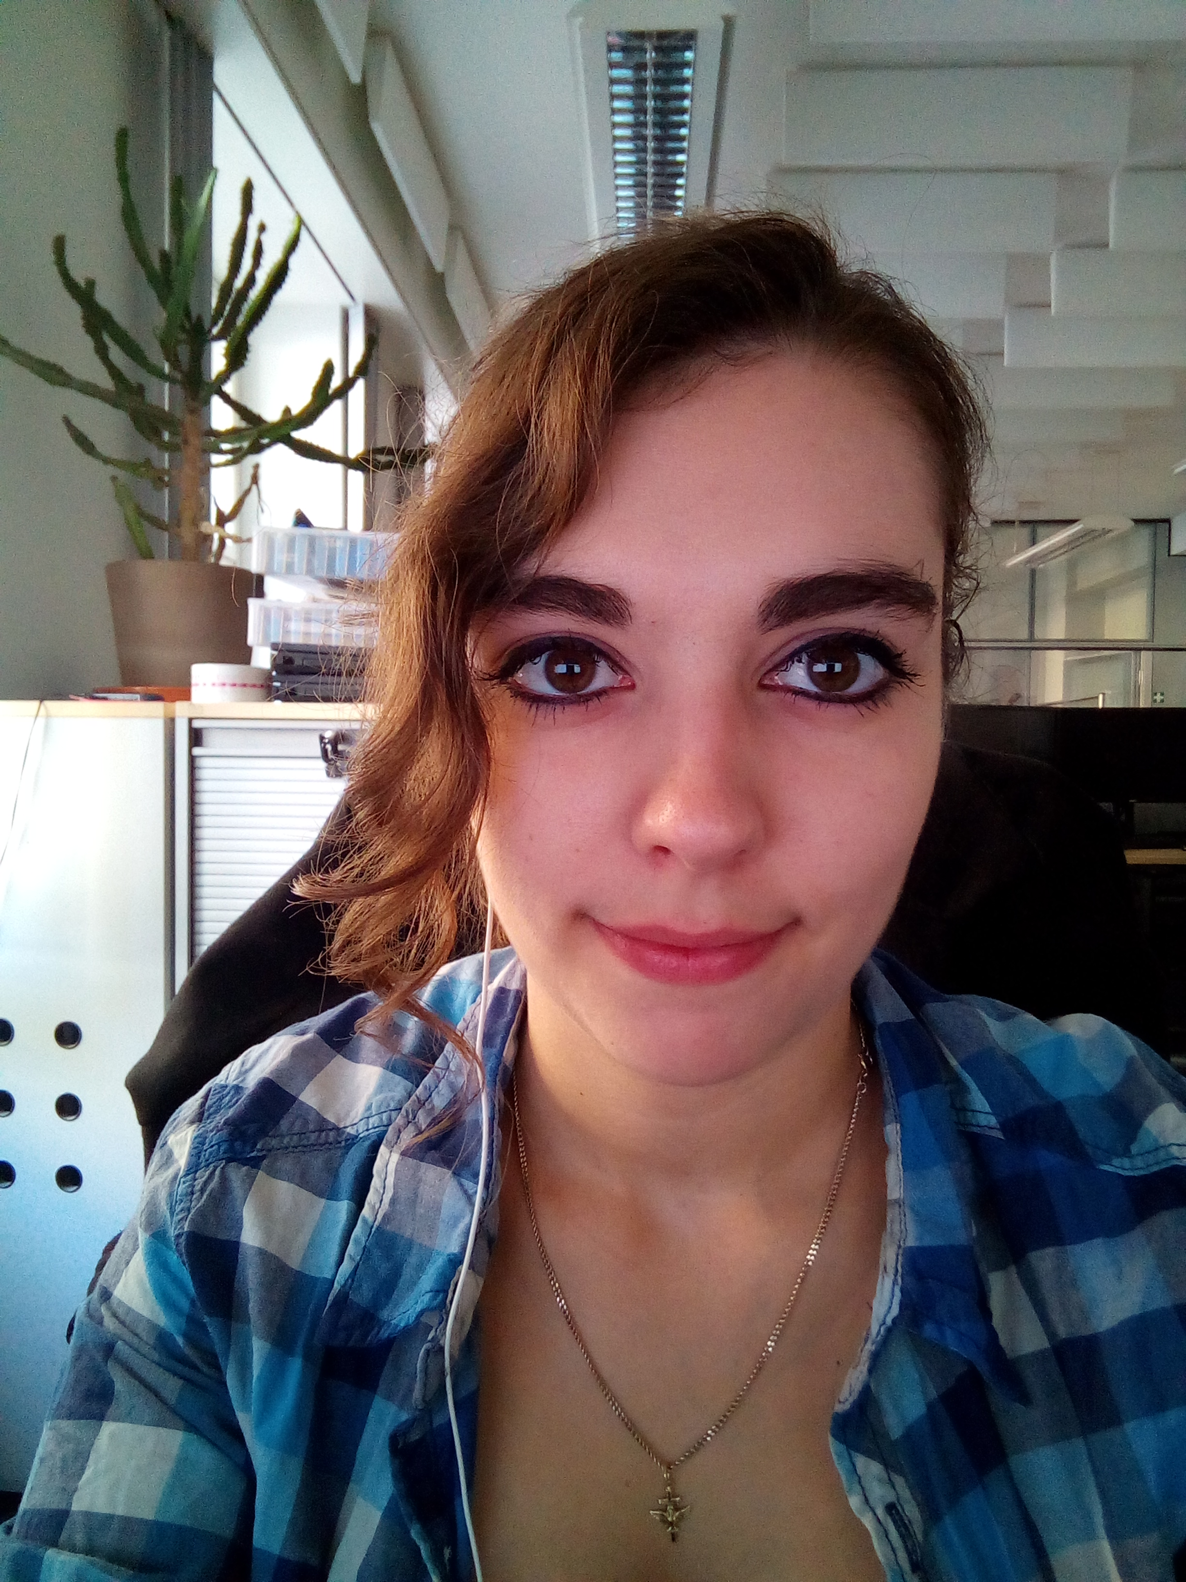
1.1 Who Are We ? – Student
Person
Education
Today
Name : Janika Schäfer
Age : 21
From : Berlin
Vocation : IT systems technician
studying : bachelor of engineering in communication & media computer science
Company : Deutsche Telekom AG
Business Unit : Business Applications & Cloud Services
finished 2015
with Abitur
1. Introduction
2. TelekomCLOUD + OpenStack
3. OpenStack In Practice
4. Q & A

Slide 7
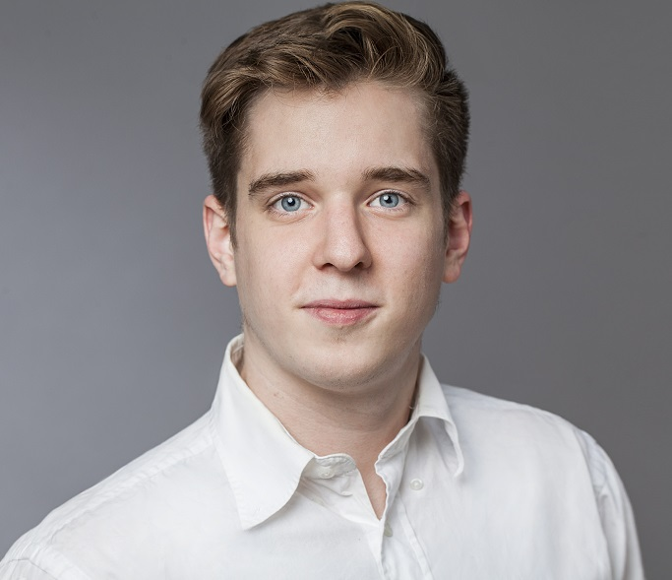
1.1 Who Are We ? – Apprentice
Person
Education
Today
Name : Oliver Klippel
Age : 23
From : Berlin
Abitur
Vocation : IT specialist for systemintegration
Company : Deutsche Telekom AG
Business Unit : Business Applications & Cloud Services
Apprenticeship until 2018
1 semester computer science & 1 semester media computer science
1. Introduction
2. TelekomCLOUD + OpenStack
3. OpenStack In Practice
4. Q & A

Slide 8
1.2 Our Workflow – A. Perri
4
Create Refcard
writing down (structured)
comply with the corporate design
use supporting illustrations
3
Documentation
gather information unfiltered
screen information
organize them
2
Conception
what is important ?
what is asked for ?
time management
1
Get an Overview
understand the task/topic
clear up questions
get inspired by other refcards
1. Introduction
2. TelekomCLOUD + OpenStack
3. OpenStack In Practice
4. Q & A

Slide 9
1.2 Our Workflow - J. Schäfer/O. Klippel
Get An Overview
DevStack As Testplatform
Setting up DevStack
Install Wordpress
Create Tenant
Automatic Rollout
1. Introduction
2. TelekomCLOUD + OpenStack
3. OpenStack In Practice
4. Q & A

Slide 10



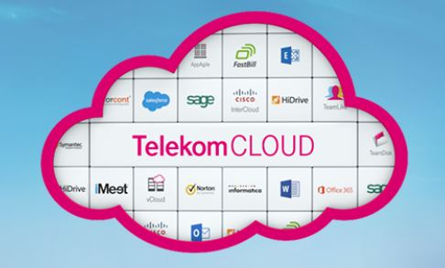

1.2 Our Workflow
Our Experiences
self-management
tools to use
find solutions
discover talents
how to get on a demanding topic
explore new thematic
understand relations
1. Introduction
2. TelekomCLOUD + OpenStack
3. OpenStack In Practice
4. Q & A

Slide 11
2. TelekomCloud + OpenStack

Slide 12
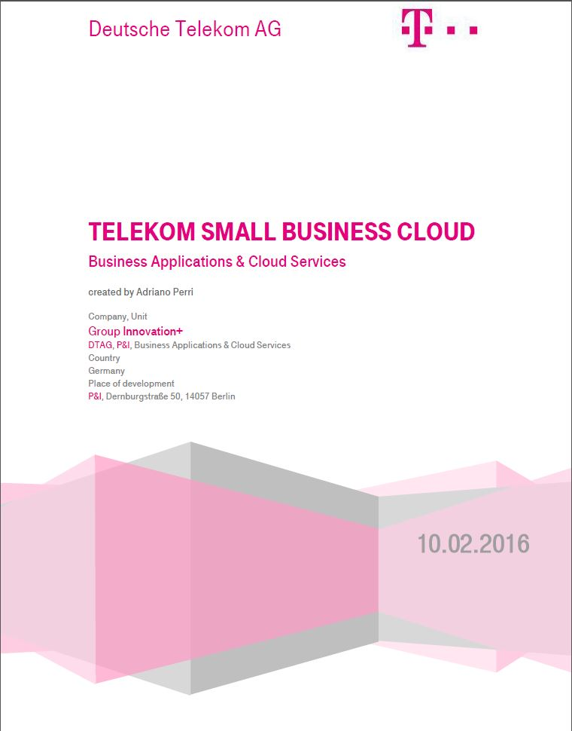
2.1 Refcard – Overview
Introduction
DevOps goals
OpenStack
Features
Software Overview
TelekomCLOUD
Deployment
Command lines
Key Terms
Picture: Refcard Telekom SMB Cloud
1. Introduction
2. TelekomCLOUD + OpenStack
3. OpenStack In Practice
4. Q & A

Slide 13
2.2 Our Deployment – Services We Use
Service Name | Function
Nova (Compute) | Virtual Machine Management
Neutron (Networking) | Network Management
Cinder (Block Storage) | Storage Resource Management
Keystone (Identity Service) | Identity Management
Glance (Image Service) | Image Management
RabbitMQ (Message Oriented Middleware) | Communication Management
Razor (Bare-Metal Provisioning) | Process of Installing an Operating System
Ceph S3 (Object Storage) | Storage Resource Management
1. Introduction
2. TelekomCLOUD + OpenStack
3. OpenStack In Practice
4. Q & A

Slide 14

2.2 Our Deployment – Datacenter
brand new datacenter Biere near Magdeburg
largest cloud datacenter in germany
40.000 m² area
high security through complex security systems
12 emergency power generators
high availability
we give the resources you need !
1. Introduction
2. TelekomCLOUD + OpenStack
3. OpenStack In Practice
4. Q & A

Slide 15
3. OpenStack in Practice

Slide 16






3.1 OPenStack in Practice – Ci/CD in Git
Developer
Push Code
Git
GitLab CI/CI Runner
Build & Test
Deploy
1. Introduction
2. TelekomCLOUD + OpenStack
3. OpenStack In Practice
4. Q & A

Slide 17


3.2 OPenStack in Practice – Video
Cloud Kindergarten –
Creating a tenant
with OpenStack
1. Introduction
2. TelekomCLOUD + OpenStack
3. OpenStack In Practice
4. Q & A

Slide 18

Thank you for your Attention !!

Slide 19
Sources
Informations
https://dzone.com/refcardz/getting-started-openstack-most
Pictures
http://www.ofekcloud.com/media/images/1e7b5ca3-8b2e-4e2e-9898-5df978f0218aimage14.jpeg ( Slide #10 CC)
http://www.all-stars.de/blog/wp-content/uploads/2014/04/planung.jpg (Slide #10 Planning)
http://www.maclife.de/ratgeber/microsoft-office-ios-jetzt-icloud-unterstuetzung-10062588.html (Slide #10 Office Tools)
http://yourdost.com/blog/2016/02/how-to-become-more-creative.html (Slide #10 Creative)
http://www.embritas.lt/project/duomenu-apdorojimo-centras/?lang=de (Slide #14 Datacenter Biere)
https://www.openstack.org/brand/openstack-logo/logo-download/ (Slide #10,#1 OpenStack Logo)
https://cloud.telekom.de/ (Slide #14 TelekomCLOUD)
http://cloud-computing-blog.eu/was-ist-jetzt-eigentlich-cloud-computing/
https://www.openstack.org/
Other Sources : AiolosSystemDescription.pdf; Telekom Small Business Cloud_Refcard for ISVs.pdf
https://gitlab.com/uploads/project/avatar/250833/runner_logo.png (Slide #17 Git Runner Logo)
http://www.autotestingtools.com/devops (Slide #17 Deploy Logo)
https://d30y9cdsu7xlg0.cloudfront.net/png/27703-200.png (Slide #17 Developer)
https://gitlab.com/uploads/project/avatar/13083/gitlab-logo-square.png (Slide #17 GitLab Logo)
http://copting.de/wp-content/uploads/kreuz-rot.png (Slide #17 cross)
http://copting.de/wp-content/uploads/Haken-gr%C3%BCn-284x300.png (Slide #17 hook)
https://de.pinterest.com/pin/556053885218068326/ (Slide #19 Background)

Slide 20
4. Questions & Answers

